Slide 1
Bilinguals Hear the World Differently: Language Experience Changes Audiovisual Perception
Viorica Marian, Sayuri Hayakawa, Tuan Q. Lam, & Scott Schroeder
Brain Sciences, May 2018

Slide 2
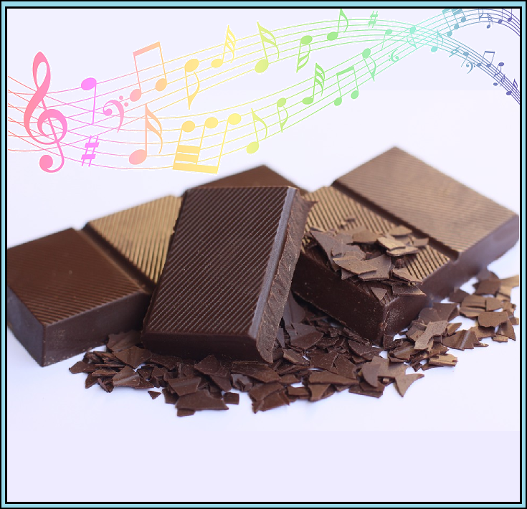
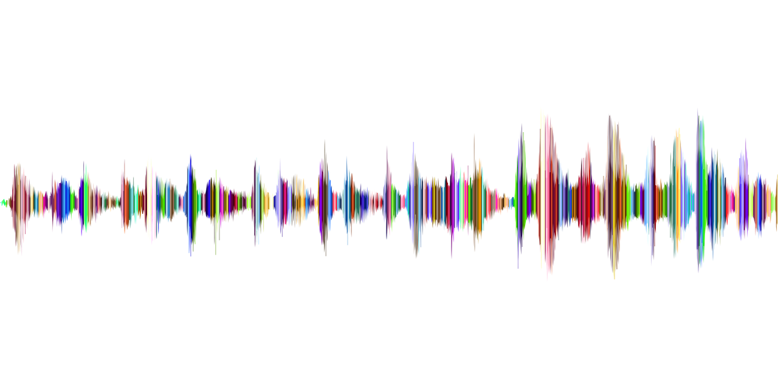
We naturally integrate our sensory experiences (taste, smell, etc.)
Listening to smooth music makes chocolate taste creamier -- just one example of how our senses interact.
Carvalho, F. R., Wang, Q. J., van Ee, R., Persoone, D., & Spence, C. (2017). “Smooth operator”: Music modulates the perceived creaminess, sweetness, and bitterness of chocolate. Appetite, 108, 383-390.

Slide 3
The McGurk Effect: What you see affects what you hear
McGurk, H., & MacDonald, J. (1976). Hearing lips and seeing voices. Nature, 264(5588), 746-748.
What do you hear in these two videos?
AsapSCIENCE (http://www.asapscience.com)

Slide 4
The two audio files were in fact identical! You may be able to voluntarily shift what you hear in this video by looking from left to right.
AsapSCIENCE (http://www.asapscience.com)

Slide 5
We report a new discovery that bilinguals experience more McGurk effects than monolinguals.
In other words, your language experience can change how much you integrate what you see with what you hear.

Slide 6
Why might this happen?
It can be harder for bilinguals to understand speech (Mayo, Florentine, & Buus, 1997).
Bilinguals have to split their time practicing two languages rather than one (Gollan, Montoya, Cera, & Sandoval, 2008).
Multiple languages can compete with each other (Marian & Spivey, 2003).
Visual information can help people understand speech (Navarra & Soto-Faraco, 2007).
Even bilingual babies look more at the mouths of speakers than monolinguals (Pons, Bosch, & Lewkowicz, 2015).
Bilinguals may therefore learn to rely more on what they see to process what they hear.

Slide 7
The Experiment
Three groups of participants:
Native English monolinguals
Early Korean-English bilinguals = learned English before 7 years old
Late Korean-English bilinguals = learned English after 7 years old
They watched a video of a woman saying a syllable (e.g. “ba”) and had to identify what they heard
Sometimes the audio and video matched (audio: “ba” & video: “ba”)
Sometimes they mismatched (audio: “ba” & video: “ga”)
The McGurk effect is when people “fuse” mismatching inputs and hear a completely different sound (e.g. “da”).

Slide 8
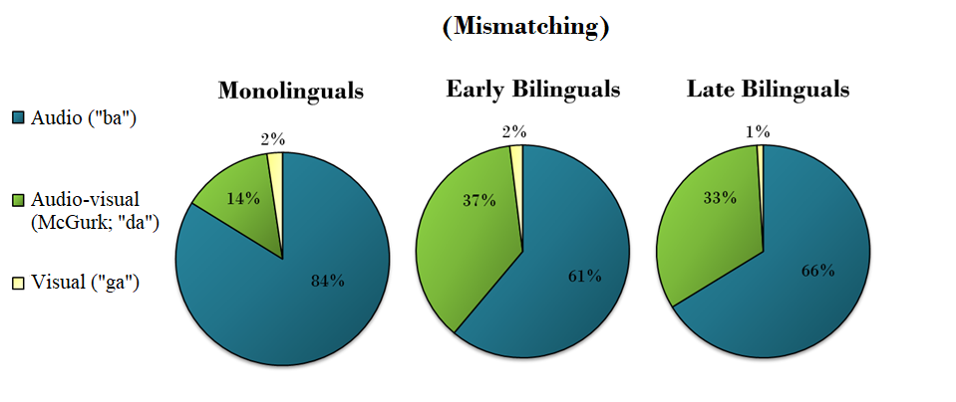
The McGurk Effect
Both early and late bilinguals experienced more McGurk Effects than monolinguals.

Slide 9
Conclusion
Bilinguals experience greater audio-visual integration than monolinguals

Slide 10
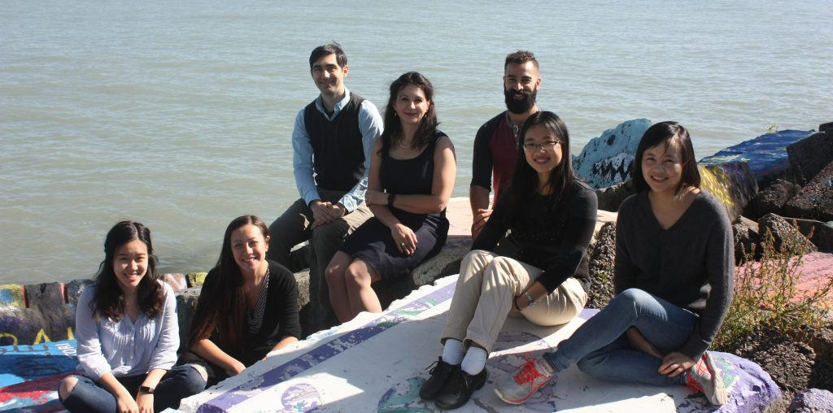
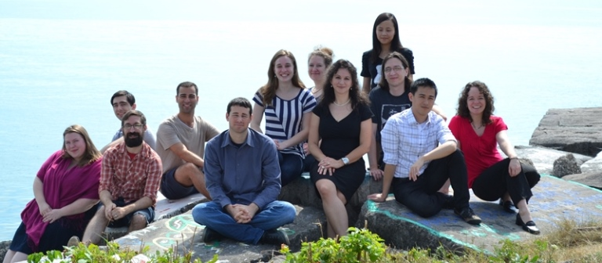
Thank You
The NIH for their funding: NICHD RO1HD059858 & NIDCD T32-DC009399-04
Peter Kwak and Jaeryoung Lee for their technical assistance
Dr. Ken W. Grant for sharing his stimuli
Members of the Bilingualism and Psycholinguistics Research Group for their helpful comments

